Slide 1
Embracing Challenges
with
Acceptance
Brian O’Sullivan, LMFT
Okinawa, Japan

Slide 2
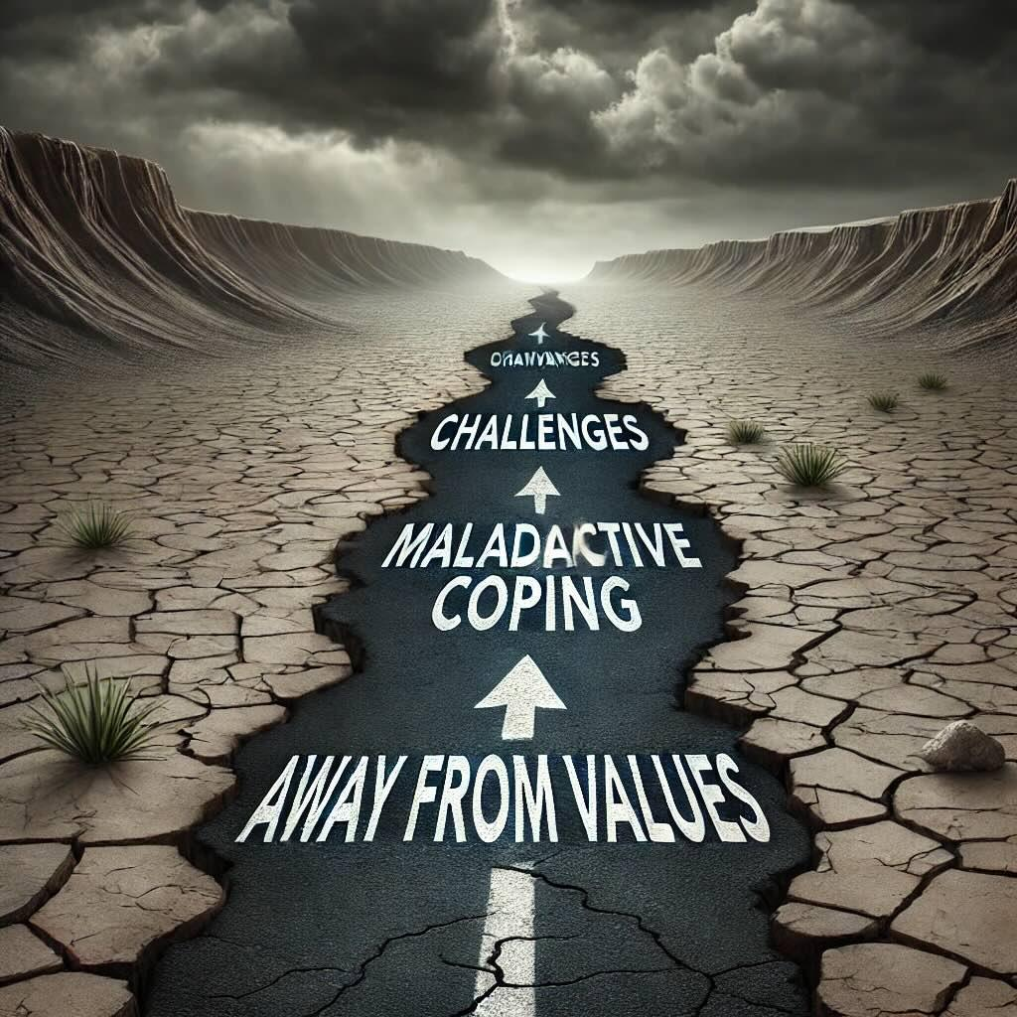
Away from
Values
Maladaptive
Coping
Challenge

Slide 3
Maladaptive Coping
Avoidance: Procrastination, withdrawal, denial
Over-Control: Perfectionism, excessive planning, rumination/worry
Numbing: Binge-watching, overeating, substances

Slide 4
Maladaptive Coping
Cognitive Fusion + Experiential Avoidance

Slide 5
Maladaptive Coping
Stuck in Thoughts + Avoiding Feelings

Slide 6
Away from Values
Towards Values
Hooked
Unhooked
Challenge
Situations, Feelings, Thoughts

Slide 7
How do we unhook?

Slide 8
Be Present
Psychological
Flexibility
Open Up
Do what
Matters

Slide 9

Open Up
Willingness
Emotions

Slide 10
Emotional Control
Willingness
Emotions
Suffering

Slide 11
Acceptance
Willingness
Emotions
Suffering

Slide 12

Be Present

Slide 13
Being Present
A - Acknowledge
C - Come back into the body
E - Engage with the world

Slide 14

Do What Matters

Slide 15
Who do you look up to in times like these?

Slide 16
What advice might you give a close friend in a similar situation?

Slide 17
Imagine your future self…

Slide 18
Despite the storm…
What’s one small step you can take?

Slide 19
Be Present
Psychological
Flexibility
Open Up
Do what
Matters

Slide 20
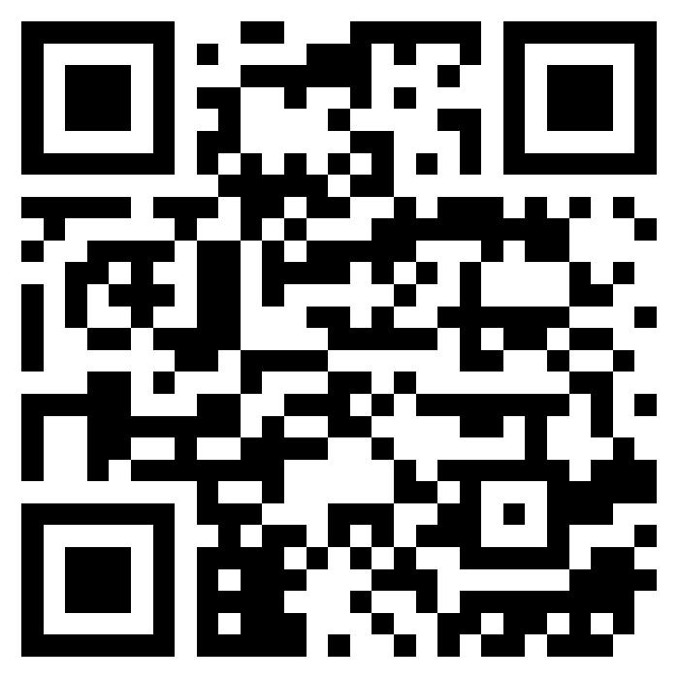
Thank You!
Brian O’Sullivan, LMFT

